Slide 1

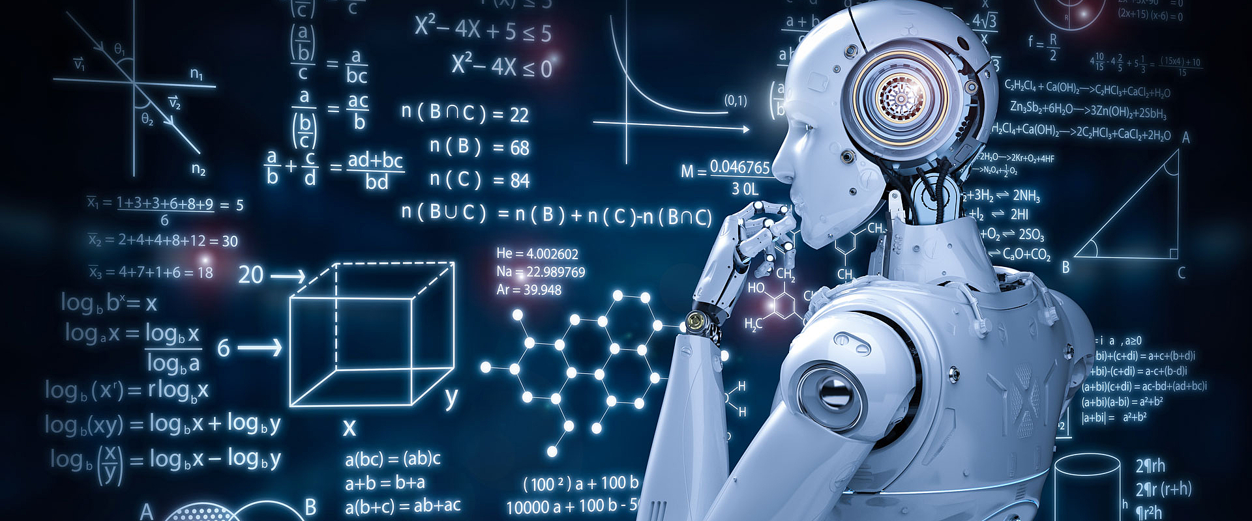
Advanced Machine Learning Semester Project
Jamo Sharif, 11-453-388
Michael Vuong, 16-925-950
Pierre Obermaier, 14-591-861
July 15, 2025

Slide 2
Motivation
Real World tasks like:
Emergency call transcription
Live chat moderation
Voice assistant pipelines
Need early detection of entities like names, locations, dates
Cannot afford to wait for full text to run NER
Goal: Run NER only when needed, while maintaining accuracy + speed

Slide 3
Formal Problem Setting
Given a token sequence: X₀:t = ⟨x₀, x₁, ..., x_t⟩ (incrementally arriving)
At each time step t, the system sees only the prefix X₀:t = {x₀, ..., x_t}
Our objective is to learn a function f(X₀:t) that decides:
→ Should we invoke NER now?
→ Or should we wait?
We aim to minimize: L(f) = Σₜ L_NER(ŷₜ, yₜ) + λ ⋅ C(f)
L_NER: token-level NER loss
C(f): invocation penalty (calls, latency)
λ: trade-off parameter

Slide 4
Dataset & Evaluation Protocol
Dataset: OntoNotes 5.0 (english_v12, HuggingFace)
Annotated with entity spans (BIO format)
Used standard document-level split:
Train: 80%
Validation: 10%
Test: 10%
Streaming Simulation:
At time t, only tokens x₀,...,x_t are revealed
Decision must be made incrementally

Slide 5
Data Preprocessing Pipeline
1. Token-Level Entity-End Classifier
Predict if a complete entity ends at the current token (Y=1), or not (Y=0)
For each sentence:
Extract: words, named_entities (BIO tags)
At each timestep t, keep prefix X₀:t
Create Label Y(t):
Y(t) = 1 if a named entity ends at token t
Input Representation:
Tokenize prefix using BERT tokenizer
Extract [CLS] token embedding
Store (X_cls, Y) pairs
Save as NumPy arrays

Slide 6
Data Preprocessing Pipeline
2. Window-Based Trigger Classifier
Predict if a window contains a complete entity
For each sentence:
Create window of size 6
If the sentence length is smaller than 6, then concatenate with next sentence
Label each window:
Y = 1 if it contains at least one complete entity
Embeddings:
Get cls embeddings for each window
Save (X, Y) pairs:
X: Embeddings of windows
Y: Label (1, 0)

Slide 7
Hyperparameters
Threshold (τ)
Controls trade-off between precision and recall
Determines when to invoke NER
Challenge: (1) Requires tuning via validation (2) Expensive: full validation sweep over τ is resource-intensive
Embedding type
Word2Vec: (+) Fast, lightweight (-) No context awareness
BERT CLS: (+) Rich contextual info (-) Requires full BERT inference
Model related parameters
--> Learning rate (lr), number of epochs, architecture depth
Trade-off:
Simpler models = faster training
Complex models (e.g., deep Neural Networks) = longer runtime, need more resources
Due to compute constraints, we opted for compact MLPs; tuned parameters manually within small search space

Slide 8
Evaluation Metrics (Overview)
1. Entity Detection Quality
Time to First Detection (TTFD)
F1 score (entity completion)
2. Computational Cost
NER calls saved vs. always-on
Classifier inference cost
3. Classifier Performance
Precision / Recall / F1
Trade-off between early call and false positive

Slide 9
Strategy 1 — Confidence Thresholding
Train binary classifier:
Input: CLS token from BERT over X₀:t
Output: p(entity completed) ∈ [0,1]
At inference:
If p > τ → invoke NER
Else → wait
Threshold τ tuned on validation set
Labels constructed from BIO tagging → detect when entity ends

Slide 10
Illustrative Example (Confidence Thresholding)
Sentence: Pierre (t = 0), Jamo and Michael are master students and currently studying at the University of Zurich
Incrementally partitioned sentence:
Pierre
Pierre,
Pierre, Jamo
Pierre, Jamo and
Pierre, Jamo and Michael
Pierre, Jamo and Michael are
...

Slide 11
Illustrative Example (Confidence Thresholding)
Sentence: Pierre (t = 0), Jamo and Michael are master students and currently studying at the University of Zurich
Timestep 4:
["Pierre" , "," , "Jamo", "and", "Michael"]
Y = 1
Timestep 5:
["Pierre" , "," , "Jamo", "and", "Michael", "are"]
Y = 0

Slide 12
Strategy 2 — Window Trigger Classifier
Slide fixed-length window (6 tokens) over input
Label: 1 if window contains complete entity, else 0
Models trained to detect “trigger-worthy” windows
Embeddings tried:
Word2Vec static embeddings: (1) Avg pooling (2) Max pooling
BERT CLS token (contextual)
Trained simple MLP classifier per embedding type

Slide 13
Illustrative Example (Window Inference)
Sentence: Pierre, Jamo and Michael are master students and currently studying at the University of Zurich
Sliding Window = 6 tokens:
Window 1 : Names , Y = 1
Window 5 : No entity
Window 9: Half Entity
Window 10 : Organisation
Classifier triggers BERT only for windows with potential full entity

Slide 14
Illustrative Example (Window Inference)
Sentence: Pierre, Jamo and Michael are master students and currently studying at the University of Zurich
Sliding Window = 6 tokens:
Window 1 : Names
Window 5 : No entity
Window 9: Half Entity
Window 10 : Organisation
Classifier triggers BERT only for windows with potential full entity

Slide 15
Illustrative Example (Window Inference)
Sentence: Pierre, Jamo and Michael are master students and currently studying at the University of Zurich
Sliding Window = 6 tokens:
Window 1 : Names
Window 5 : No entity Y = 0
Window 9: Half Entity
Window 10 : Organisation
Classifier triggers BERT only for windows with potential full entity

Slide 16
Illustrative Example (Window Inference)
Sentence: Pierre, Jamo and Michael are master students and currently studying at the University of Zurich
Sliding Window = 6 tokens:
Window 1 : Names
Window 5 : No entity
Window 9: Half Entity Y = 0
Window 10 : Organisation
Classifier triggers BERT only for windows with potential full entity

Slide 17
Illustrative Example (Window Inference)
Sentence: Pierre, Jamo and Michael are master students and currently studying at the University of Zurich
Sliding Window = 6 tokens:
Window 1 : Names
Window 5 : No entity
Window 9: Half Entity
Window 10 : Organisation Y = 1
Classifier triggers BERT only for windows with potential full entity

Slide 18
Architecture (Classifier)
WindowSlideModel
Input: 300 (Word2Vec) or 768 (BERT)
Layers:
Linear → ReLU → Linear → Sigmoid (binary output)
Optimizer: Adam, lr=1e-3
Loss: BCEWithLogitsLoss (with pos_weight)

Slide 19
Classifier Results (Word2Vec)
Word2Vec (Avg Pooling)
Precision: 0.7341
Recall: 0.7619
F1 Score: 0.7477
Word2Vec (Max Pooling)
Precision: 0.6790
Recall: 0.5753
F1 Score: 0.6229

Slide 20
Classifier Results (BERT CLS)
BERT CLS Token Classifier
Precision: 0.7175
Recall: 0.7881
F1 Score: 0.7511
→ Higher quality trigger detection
→ But costlier than static embeddings

Slide 21
Efficiency Results
Dataset OntoNotes
Evaluated on ~1,200 test documents
Metric | Always-On | Confidence | Window
Timesteps | 230118 | 230118 | 183876
NER Invocations | 230118 | 14733 | 43404
TTFD | 0.46 | 1.46 | 1.33
Total FLOPS | 325,569,650,375,424 | 325,724,260,216,320 | 125,249,513,445,672
Δ% FLOPS | n/a | 0.05% | -61.53%
Δ% Precision | n/a | 9.53% (Less FP) | -9.04%
Δ% Recall | n/a | -22.95% | -20.57%
Δ% F1-Score | n/a | -11.85% | -16.05%

Slide 22
Limitations
Resource Constraint
BERT-based NER is computationally expensive
Embedding generation (especially CLS tokens) slows down training & inference
Evaluation is time-intensive, limiting exploration
Model Dependency
Model performance is tied to pre-trained NER quality
Classifiers predict when to run NER, but actual entity quality depends on BERT
Latency vs. F1
Tunable threshold τ controls precision-recall balance
Choosing the optimal τ is slow without enough compute
We prioritize early detection and call reduction over peak F1

Slide 23
Conclusions
We proposed two strategies for real-time NER:
BERT-based confidence thresholding
Trigger classifiers using static/contextual embeddings
Both approaches:
Reduce NER invocations
Detect entities early while maintaining a reasonable entity recall
Are simple, interpretable, and fast to train
Confidence model less efficient due to having similar calls of tokenizer (using bert )during inference as the baseline
Sliding window model shows more promising results, reducing the FLOPS by >60%
Future work: incorporate span-based evaluation and more efficient ways to compute τ such that more meaningful statements can be made about τ

Slide 24
Team Contributions
We have met on site and worked as a Team!
Michael --> most experienced in the AI field --> Technical Team Lead
Task distribution:
Set up (Pierre, Jamo, Michael)
Problem Setting (Pierre, Jamo, Michael)
Jamo/Michael focused on Model 1
Michael focused on Model 2
Pierre focused on evaluation
Jamo prepared the slides

Slide 25

Thank you for your Attention
Questions?

